Slide 1

Competitive Programming From Problem 2 Solution in O(1)
P
T
H
I
N
K
F
A
S
T
S
C++: Functions
Mostafa Saad Ibrahim
Teaching Assistant @ Cairo University

Slide 2
Writing code for Rocket
Lets write code for rocket...How many lines to be written??
Any language allow us simplify code to blocks...our first thing to study: Functions
Simply, we will cut part of logic, put it somewhere and give it name

Slide 3
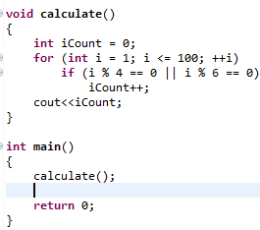
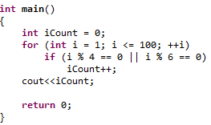
Writing a function (void)

Slide 4
Conventions in funcion name
There are styes for writing function names
Void print_table()
Void printTable()
Void PrintTable()
Any company will have 1 specific style to follow
See Google: http://google-styleguide.googlecode.com/svn/trunk/cppguide.html

Slide 5
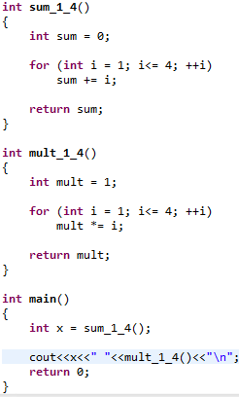

Function with return

Slide 6
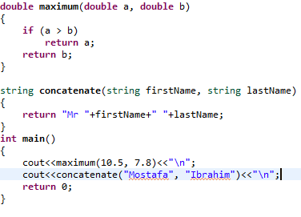

Function with parameters

Slide 7
Function prototype
<Return> FunctionName(Parameters List)
void printMenu();
int min(int a, int b);
int factorial(int a);
string readName();
int main();
To call it, respect its prototype

Slide 8
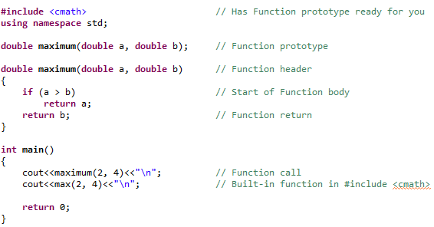
Function elements

Slide 9
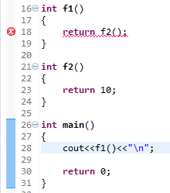
Compile Error: f2 not declared!

Slide 10
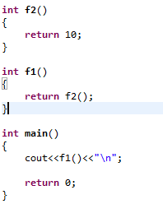
Solution 1: Order them right

Slide 11
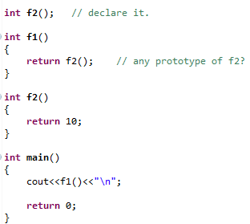
Better solution: Declare it

Slide 12
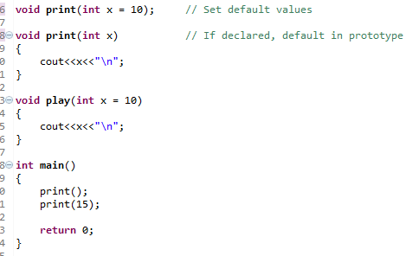
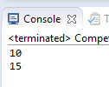
Default values

Slide 13
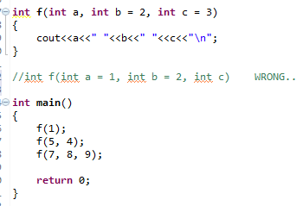

Defaults in tail of declarations

Slide 14
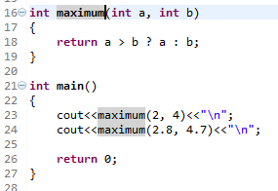
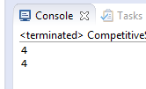
Best match function

Slide 15
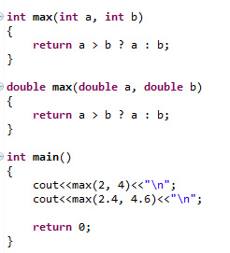

Overloading: Same Function Name + Different parameters

Slide 16
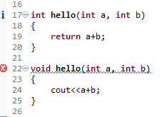
CE: Ambiguous call

Slide 17
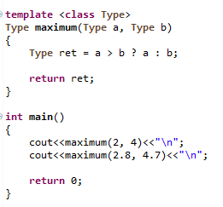
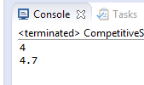
Function Template

Slide 18
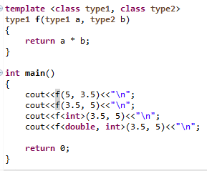
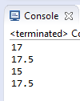
Function Template: More

Slide 19
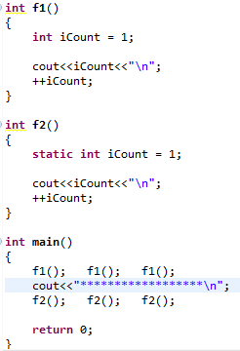

Local static variable

Slide 20
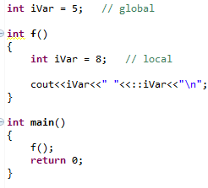

Variable Scope

Slide 21
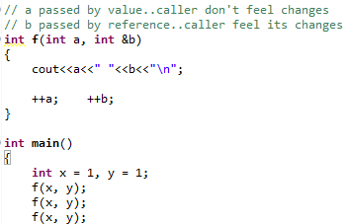
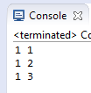
Pass by value and reference

Slide 22
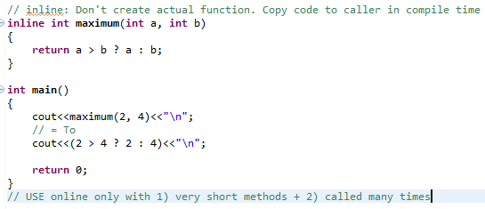
Inline Functions

Slide 23
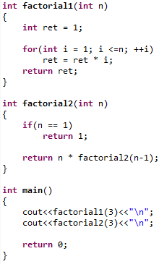

Recursive Functions

Slide 24
Built in functions
There are many built in functions..try them
Some of them math functions: e.g. Sqrt
Some of them for random numbers: rand()
Others compute program time
Others change character case
Others make beeb voice...and many others
See: http://www.cprogramming.com/function.html

Slide 25
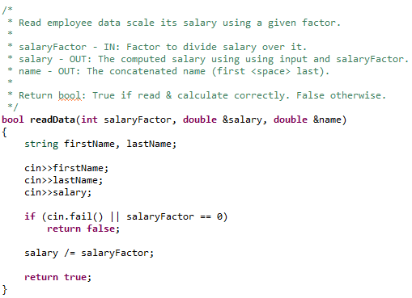
Professional Doc for Function

